Slide 1

AUTO QUESTION PAPER GENERATOR
Streamlining Exam Paper Creation
TEAM LEAD : G Ramana
TEAM MEMBERS : K Harshith
T Sai Charan
Notes:
NOTE:
To change the image on this slide, select the picture and delete it. Then click the Pictures icon in the placeholder to insert your own image.

Slide 2

INTRODUCTION
An auto question paper generator is a sophisticated Application designed to automate the process of creating examination papers.
A good exam gives all students an equal opportunity to fully demonstrate their learning.
Examination is one or more activity that recognizes, gathers, and construct data to assess the fulfillment of Course outcome and program Outcomes.
purpose:
Simplifying and automating the process of question paper generator.

Slide 3

Project Objectives
The main goal of a question paper generator is to automate the process of creating examination question papers.
The question paper generator aims to reduce the manuel effort and time by that faculty can more spend time on teaching .
Producing exam questions is challenging, monotonous and time consuming for teachers. By this teachers can spend more time on teaching .this is very helpful to all faculty .

Slide 4
Why Auto question paper generator?
Manual Paper Generation
Automatic question Paper Generation
Human process
Automated process
Totally random and unbiased
patterns
Patterns and repetitions may occur
Low security and chances of
leaking high
High security and chances of
leaking low
Slow as human labour involved
Faster due to computer
baised automation

Slide 5
Title and Content Layout
Step 1 teacher login
Enter your mail
Enter your password
Forget password-Otp
Confirm password
Step 2
Q.P generator
Submit question paper details
Get the questions and save
Preview and download pdf
Step 3 Insert Questions
Enter the question paper details
Enter the questions in given field & save
Step 4 Add Admin
Enter New admin email & password
And click on submit

Slide 6
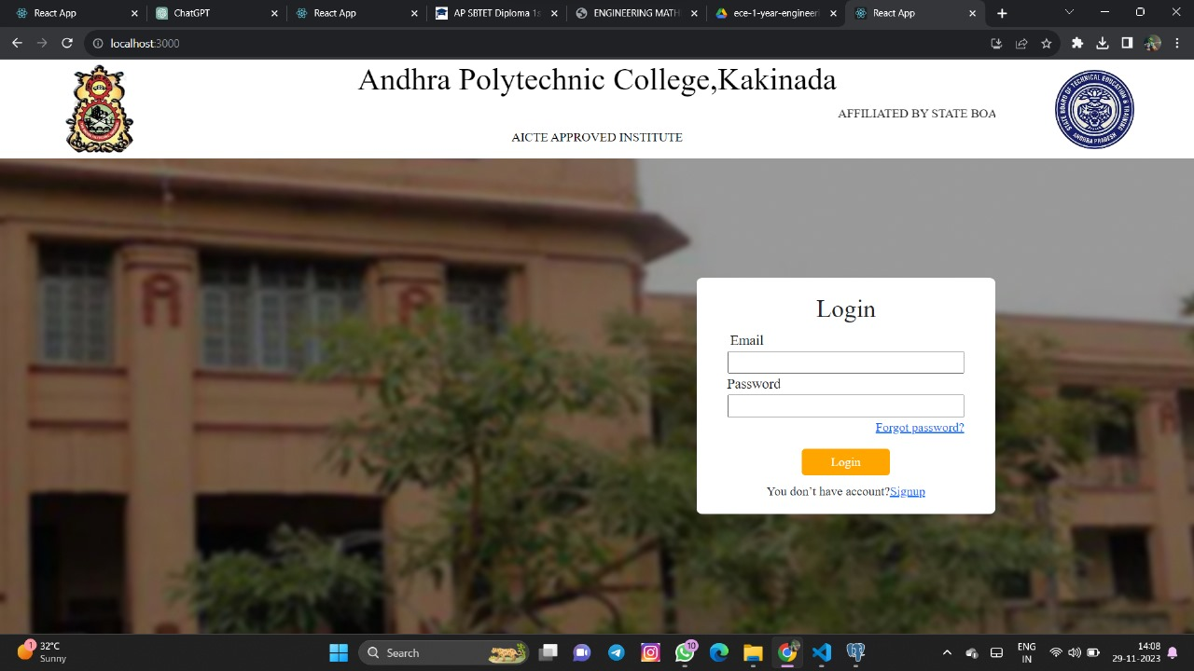
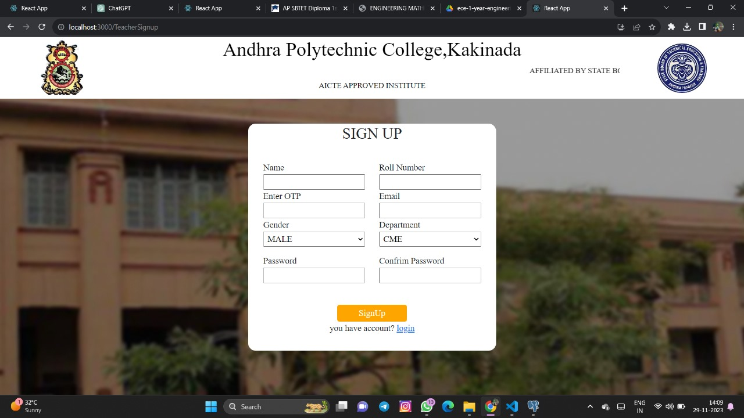
Our page of Teacher login & signup
Enter the email & password and
Click on login and enter your details to signup.

Slide 7
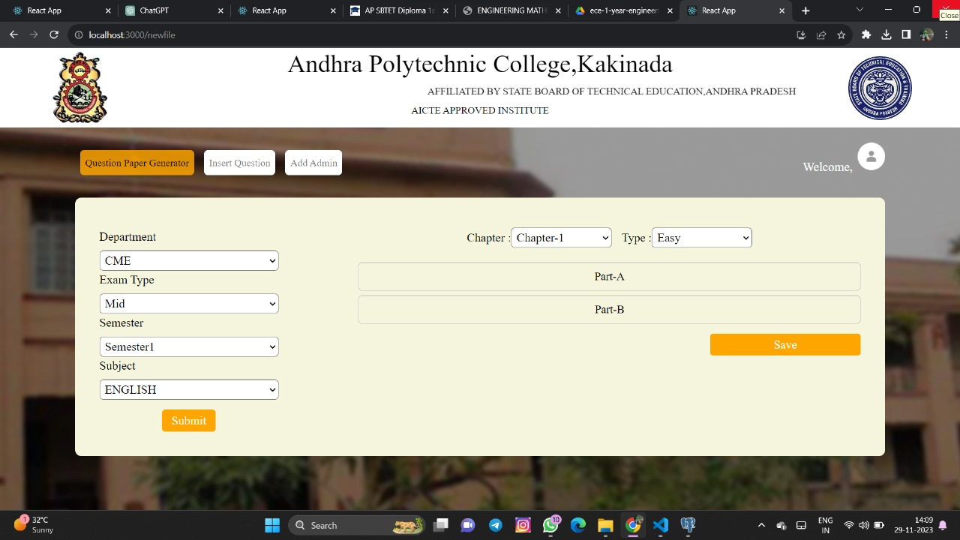
This is our Side of q.p.g - 2
Select your details to generate paper and click on submit & get the questions and save it & download the pdf

Slide 8
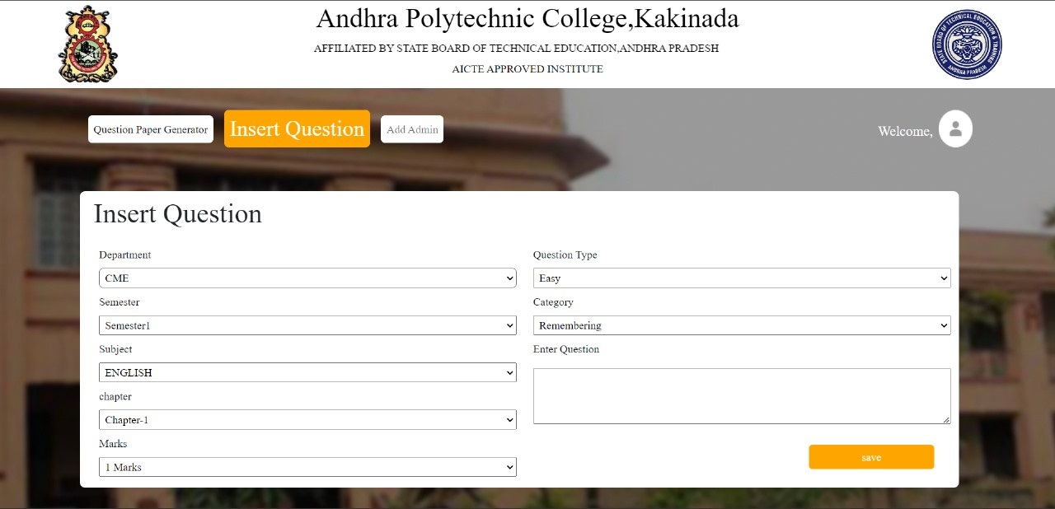
This is our slide of I.Q - 2
Select same as question paper generator but in this template enter the questions in given input field and save it

Slide 9
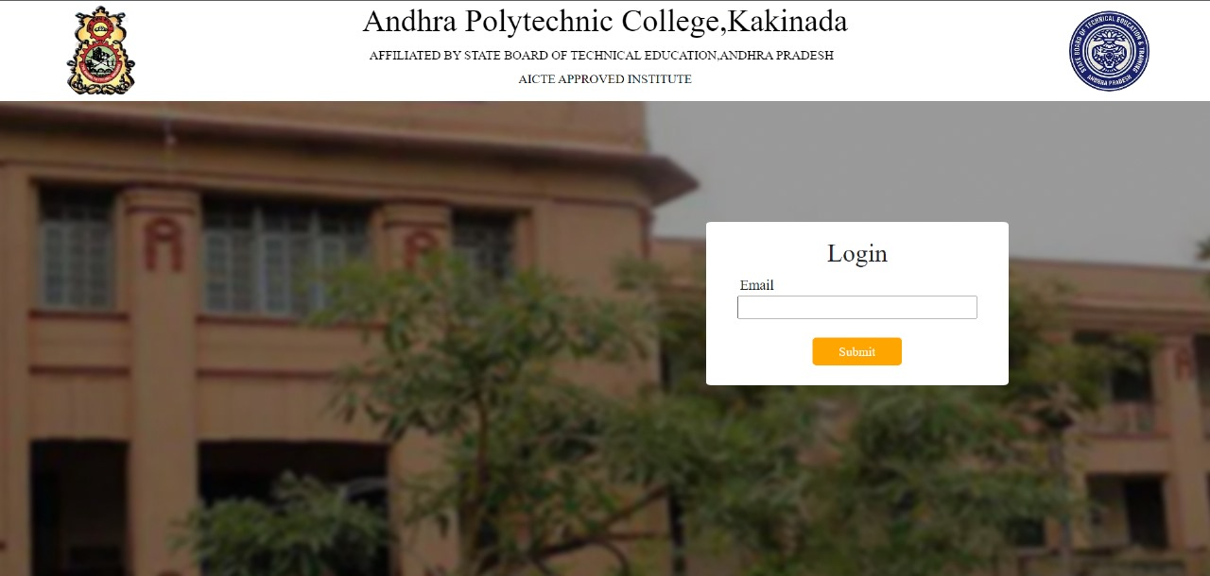
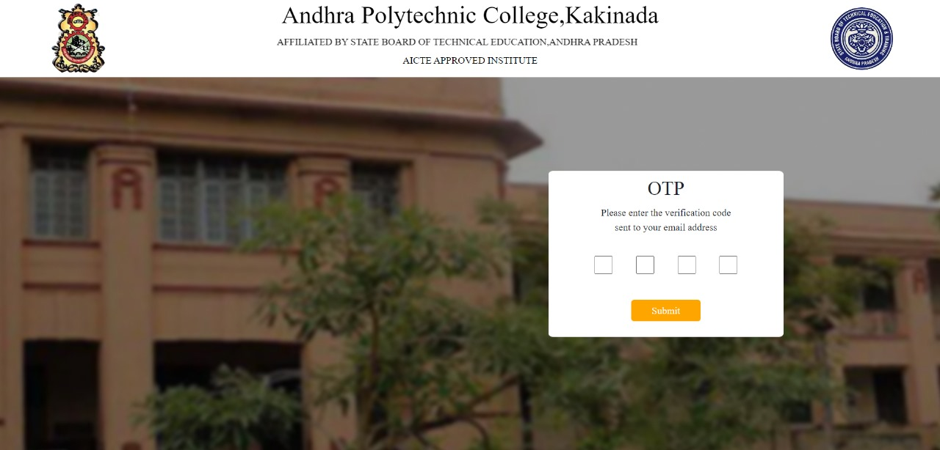
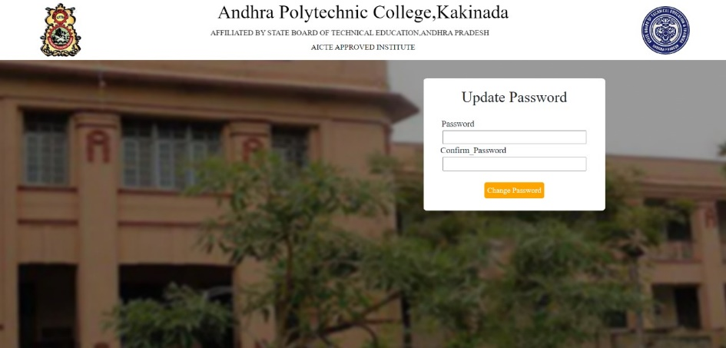
This slide is forget password - 3
To reset your password enter your email
Enter the OTP which is send to our email
Update your password .
your password is changed

Slide 10
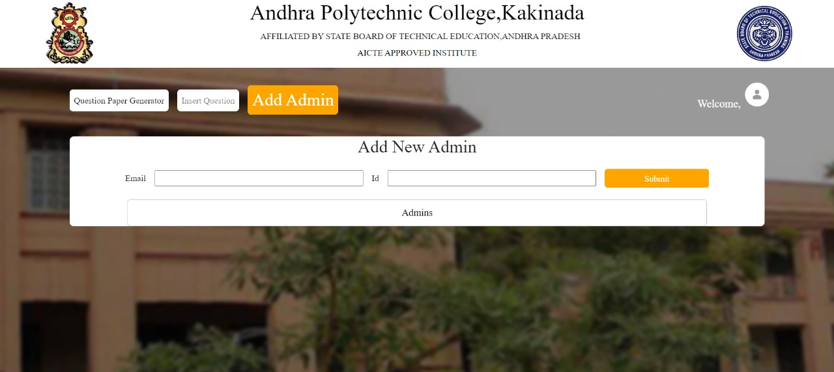
This is our slide of Add admin- 4
This is add new admin template
Only Admin can add a new
Admin

Slide 12
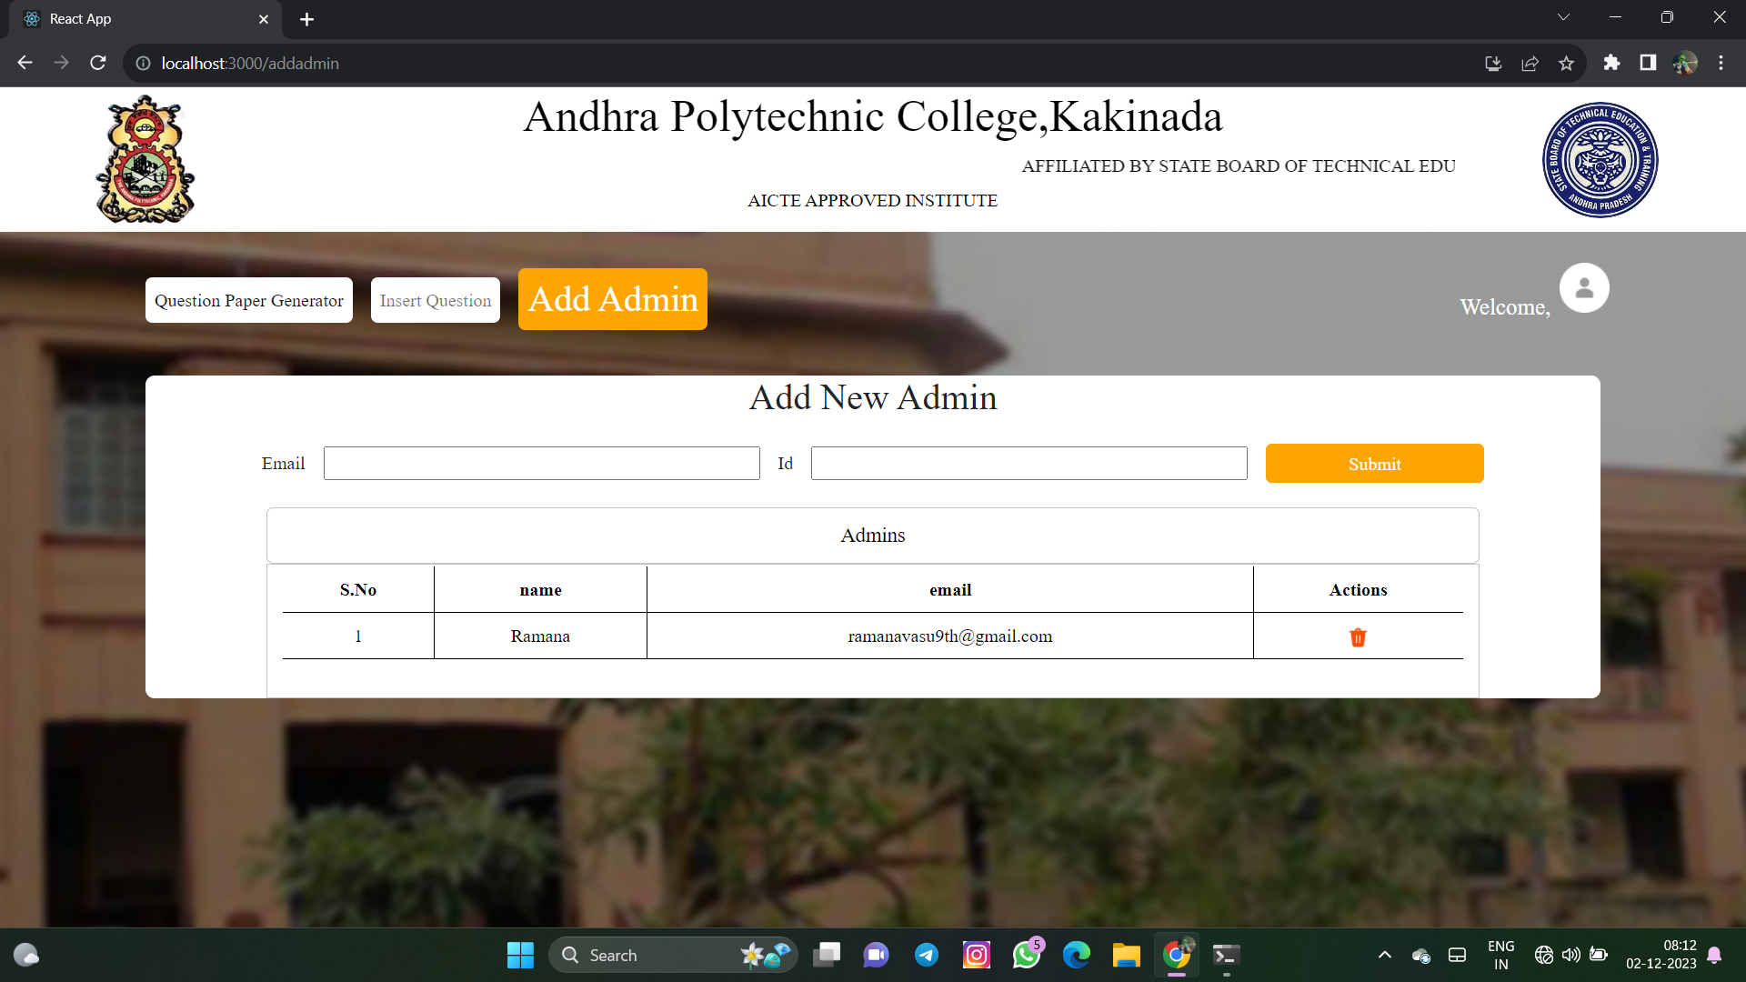

Slide 13
CHALLENGES FOR MAKING AUTOMATIC QUESTION PAPER GENERATOR SYSTEM :
1.No repetition of questions
2.Course Outcome mapping
3.Chapter wise allocation
4. Analysis of database
5. Formatting of paper
6. Paper pattern:
BENEFITS:
The benefits of an auto question paper generator are multifaceted, revolutionizing
the examination process in educational institutions.
1.Time Efficiency
2.Consistency
3.Randomization for Security
4.Scalability
5.Reducing stress

Slide 14
conclusion
THANK YOU
Assessment plays a vital role in teaching learning process.
Here there are key points:
The auto question paper generator not only optimizes time and resources but also elevates the quality, fairness, and overall efficacy of the examination process in educational institutions.
Only admin can login .
Only admin can generate question paper.
Only admin can add other new admin .
WE HOPE THAT OUR PROJECT WILL TO ALL FACULTY

